Slide 1
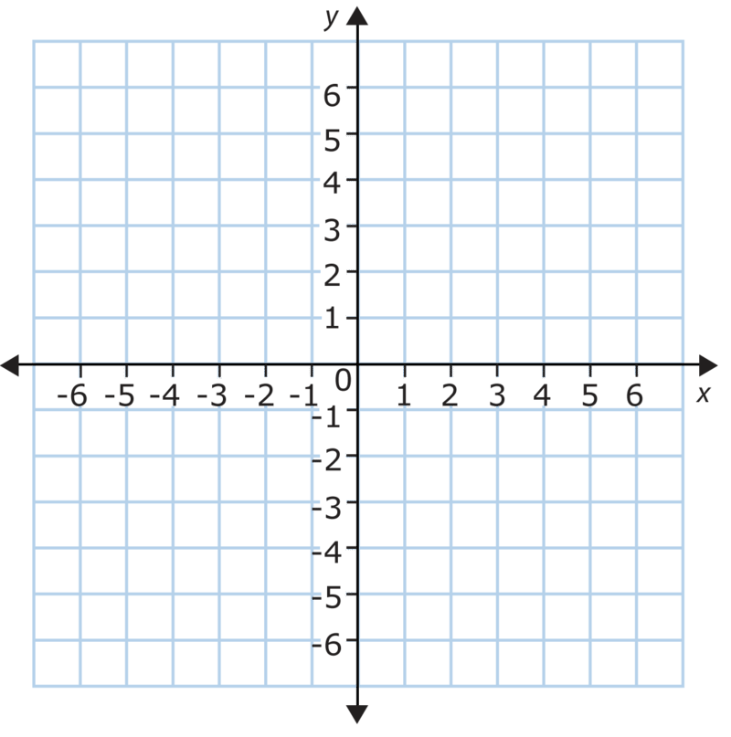
Bell Work (5-7minutes work quietly, think about the questions below)
Plot and label the following points on a graph (back of dry erase board is perfect!)
(3,6)
(-1,5)
(4,-2)
(-6,-2)
(0,5)
Think deeper: If both coordinates are positive where will the point be located? What about if both are negative? One of each (be careful here…)? Will this always be true or just for these 5 examples, how can you be certain?

Slide 2
Math analysis
Day 2

Slide 3
Bell Work (7-10 minutes discus your thought process, findings, and answer further thought questions below)
Answers
Plot and label the following points on a graph (back of dry erase board is perfect!)
(3,6)
(-1,5)
(4,-2)
(-6,-2)
(0,5)
A
B
E
D
C
Further thought: What do you notice about the placements? Why are the B and E on the same horizontal line? Why are the D and C?
What would you have to do to make A and C on the same vertical line?

Slide 4
Objective
Use a project with Pentominoes to continue our understanding of patterns, by incorporating plotting points.

Slide 5
Graphing Project (2-4 minutes… pass out graph paper and markers)
Need:
Large Graph Paper
2 different color of markers (or simply a pencil and pen)
Pentominoes Slide (coming)

Slide 6
Project Directions (Phase 1)
Select 2 or 3 of the Pentominoes on the following slide.
Create a tiled pattern on your graph paper… using the 2 or 3 Pentominoes that you select (alternate colors where you feel it is appropriate to help understand the pattern you are creating).
You will be coloring in the squares on the graph paper to make the shapes
Only fill in ½ of your graph paper with your pattern and then stop.

Slide 7
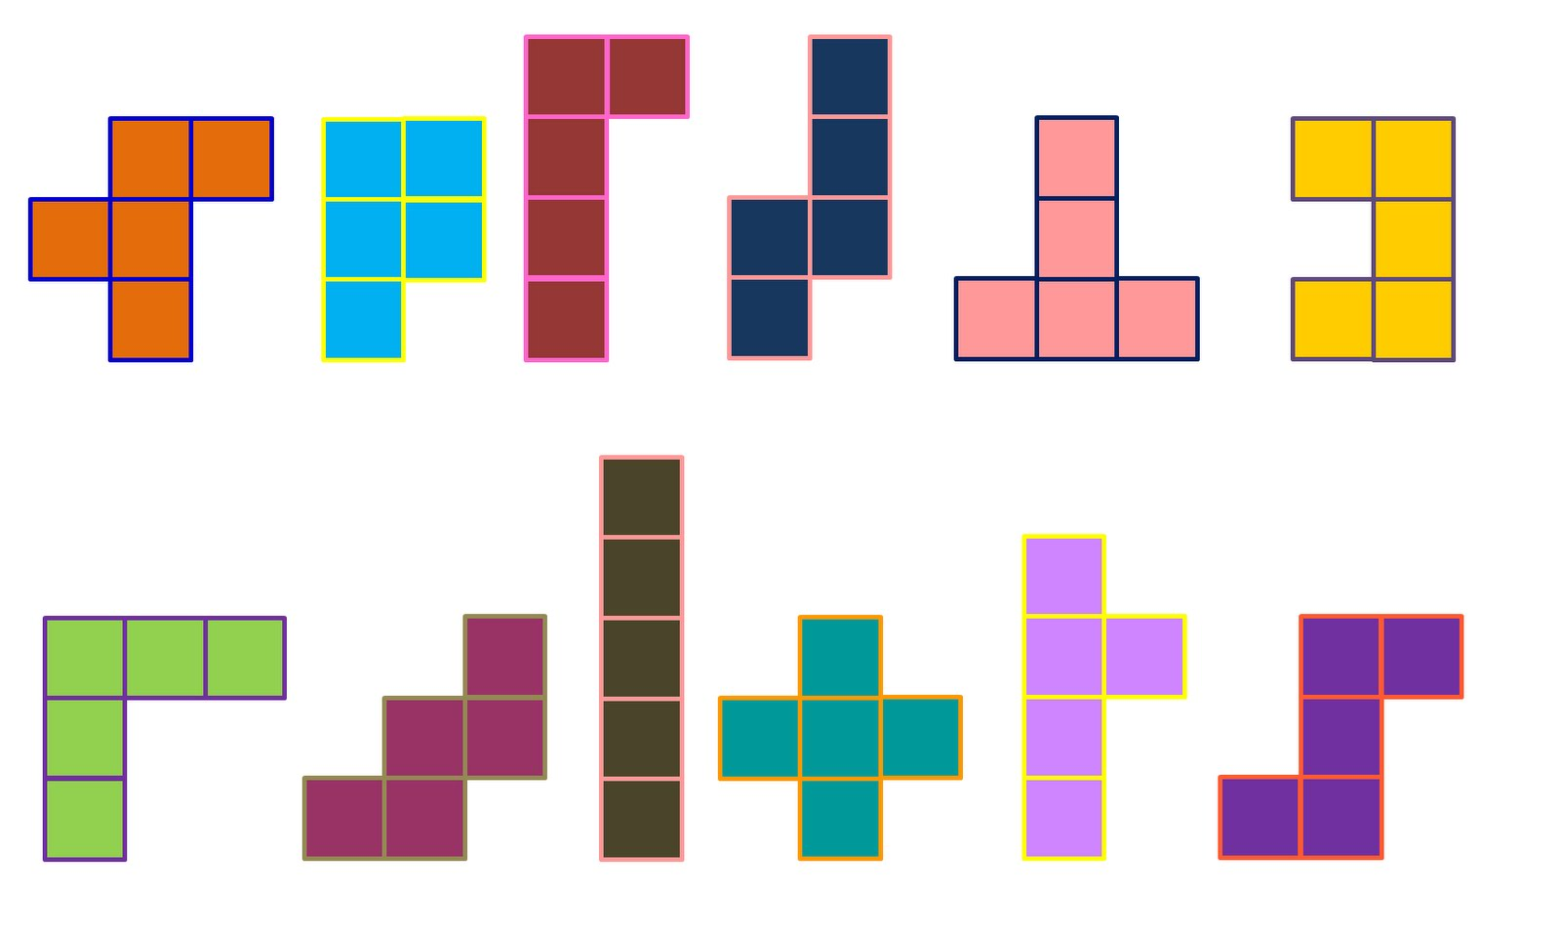
Pentominoes (you will be selecting 2-3 of these to make your pattern)

Slide 8
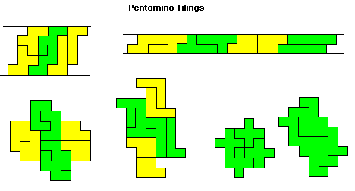
Examples of Pentomino Tiles (try to create your own, don’t just copy these…)

Slide 9
Okay… Go! Get Started with Phase 1 (15+ minutes)
Select 2 or 3 of the Pentominoes on the following slide.
Create a tiled pattern on your graph paper… using the 2 or 3 Pentominoes that you select (alternate colors where you feel it is appropriate to help understand the pattern you are creating).
You will be coloring in the squares on the graph paper to make the shapes
Only fill in ½ of your graph paper with your pattern and then stop.

Slide 10
Project Directions (Phase 2) (20ish+ minutes)
Get in groups of 2-3 people
Switch your papers so that you no longer have your own pattern
Take 3 minutes to quietly look at the pattern (do not write anything)
Take turns discussing in your groups (1-2 minutes each) on what you think the pattern is, and clarify with the originator if there are questions
Now continue to draw the pattern on your ‘new’ Pentominoes tile (in other words I will be finishing someone else’s pattern)

Slide 11
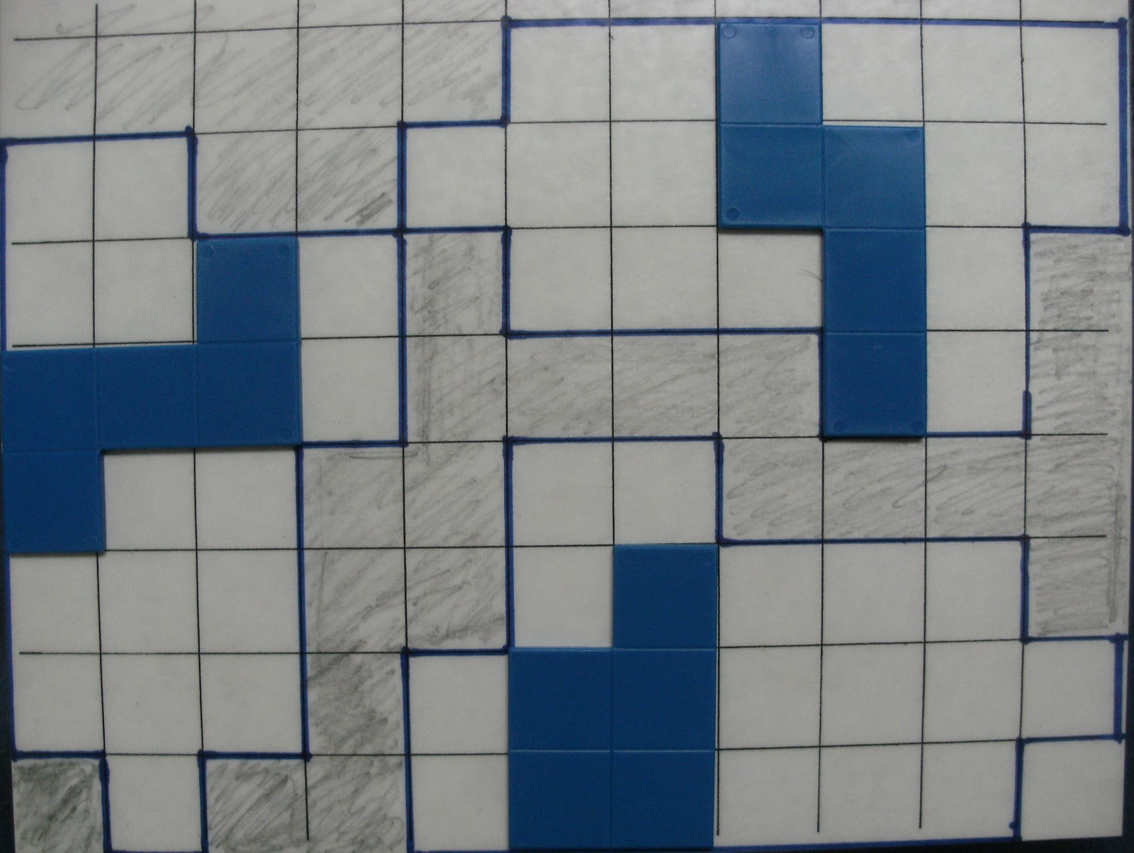
Project Directions (Phase 3) (10-15 minutes)
Identify 2 Pentominoes in each quadrant (what the heck is a quadrant?!) and outline, highlight, or identify in some way that those are the 2 you are talking about in each quadrant.
Example: The solid blue (at right) are clearly identified as the 3 you are talking about (do this in each quadrant).
■ On a separate piece of paper (or around the outside of the grid, write the all of the coordinates of the 8 individual Pentominoes.
■ Return the paper to the originator, and have them check that the coordinates in fact do correspond to the correct Pentominoes

Slide 12
Project Directions (Phase 4) (10-20 minutes)
Have one group member share one of the projects from the group. (It doesn’t have to be their own that they share).
Things to Discuss:
Most challenging piece
What went into making the pattern complete
If time permits, have the presenter read off the coordinates for 2 of their Pentominoes, and have the other groups graph their location

Slide 13
Exit Slip (5ish minutes… can be completed on back of graph paper)
What the heck is a Pentomino?
Why do you think they common in tiling floors and walls, or games like Tetris?
Where do you think it got its name, with a prefix like “Pento”?
Challenge:
Are there more Pentominoes than the ones
we worked with today? If yes, draw them. If no,
explain why there are no more.

